Slide 1
ECAL GUI - PROTO

Slide 2
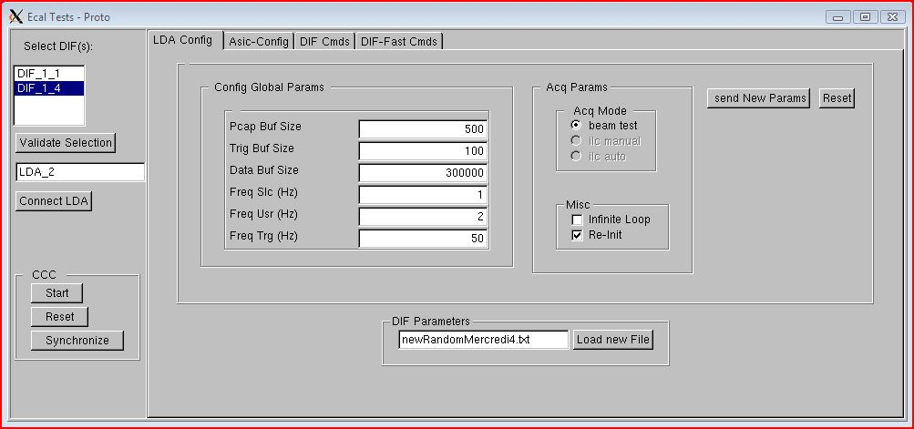
Main window1
Notes:
1 LDA - 1 DIF per LDA

Slide 3
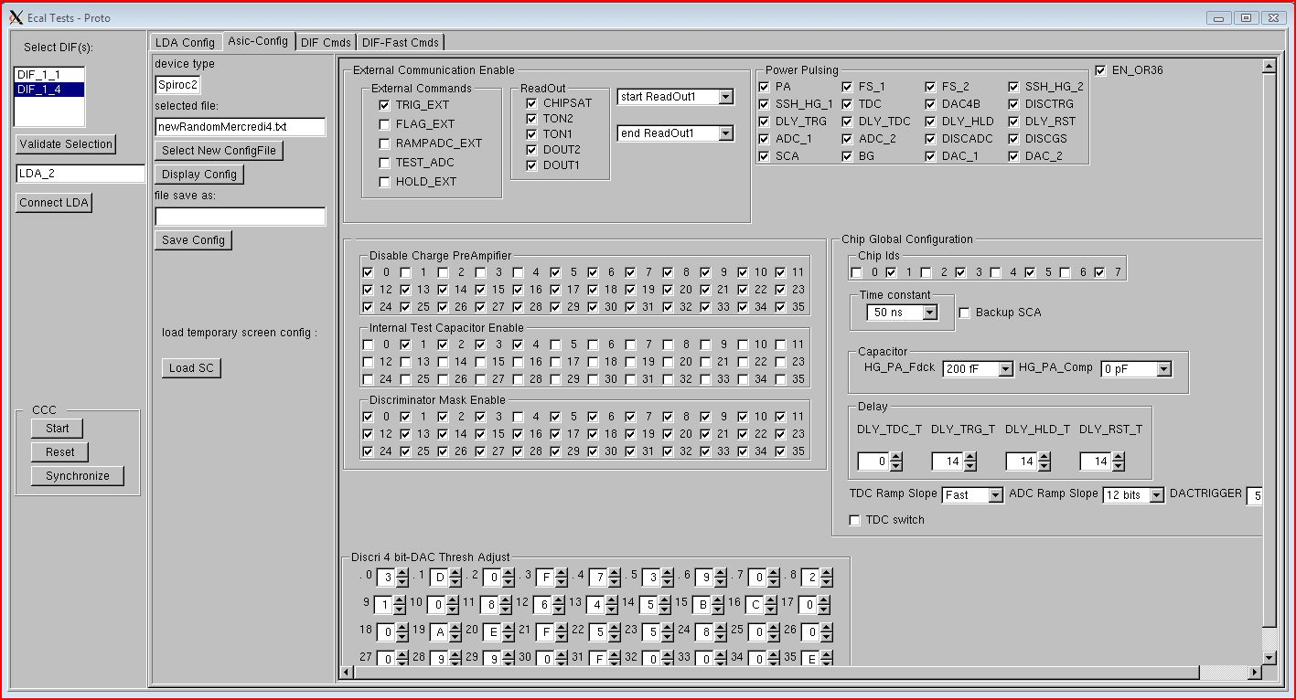
Asic Configuration

Slide 4
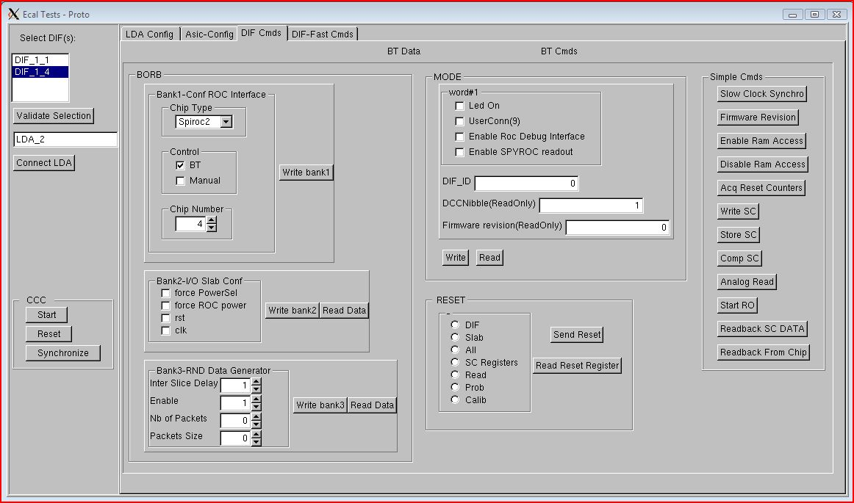
Block Transfer Commands

Slide 5
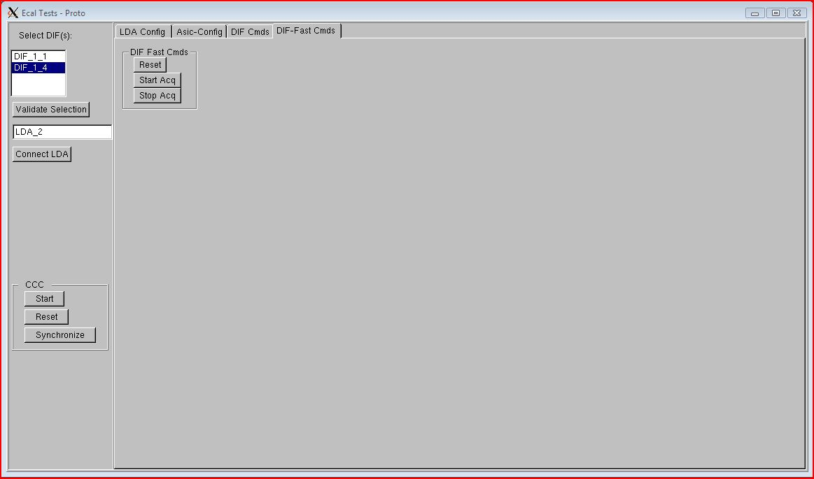
Fast Commands

